Slide 1
NPM Vulnerabilities
Samuel Steinberg, Bryan Pace, Jeffrey Dong

Slide 2
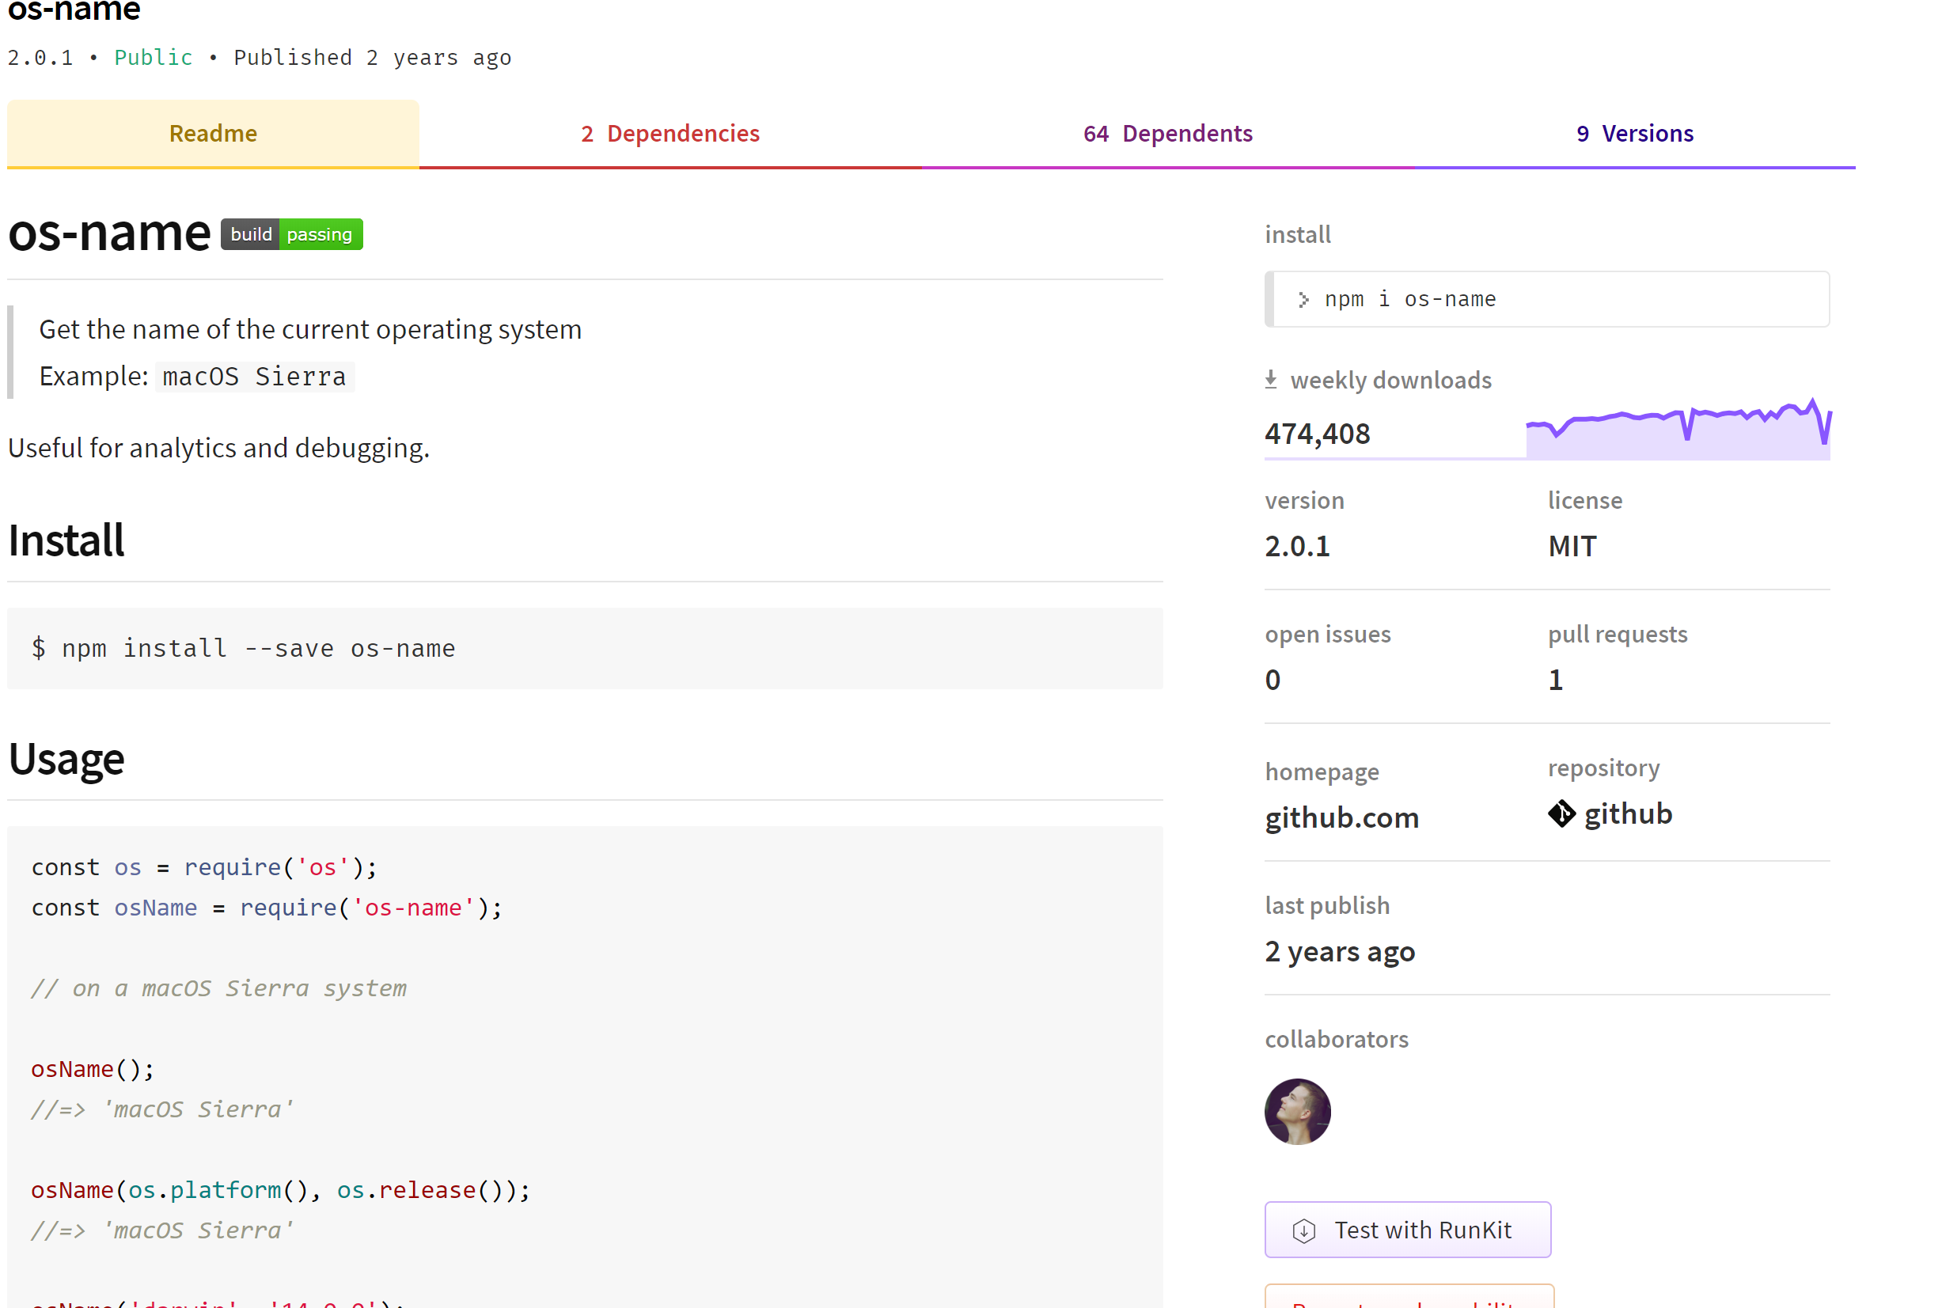
What is NPM and What Are Packages?
The NPM site is “the package manager for JavaScript and the world’s largest software registry”.
It is used primarily to install and distribute code in the form of packages, and is completely open source.
It contains both public and private packages, which can be easily searched for and installed.

Slide 3
Motivation
NPM package dependencies are downloaded with the package a user is targeting.
A malicious actor could add a package with a vulnerability as a dependency to a popular project in order to infect thousands of clients. Additionally, a bad actor could inject malicious code into a package that already exists.

Slide 4
Research Question
Is there any way to automatically detect if a particular package is malicious?
Observation: If a malicious package is added to a popular project, the number of downloads for the malicious package will increase significantly
Question: Is it possible to detect these increases in downloads and categorize them in order to find potentially malicious packages?

Slide 5
Architecture/ Methods
Read in version history for all packages being checked
Build a collection of weekly download data for each package being checked
Basic data cleaning
Analyze weekly download data to build list of significant rises/ falls
Analyze version history to build list of when packages were added/ dropped as a dependency
Compare rise/ fall lists with add/ drop lists to determine likely causes of an event

Slide 6
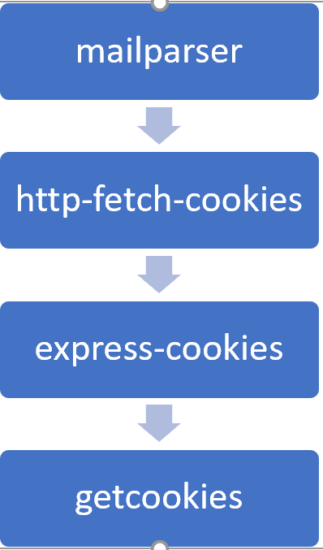
Where a Bad Package Fits In
Similar to a hacker taking over a chain of computers in order to cover up their tracks, getcookies performed the same type of malicious behavior in NPM.
How would our project detect this?
Our program would detect a rise in getcookies, which would be paired with a similar add/drop date on express-cookies.
This would be categorized as an add/drop event. This is one of the most suspicious categories, which would flag getcookies as a package with a potential vulnerability.

Slide 7
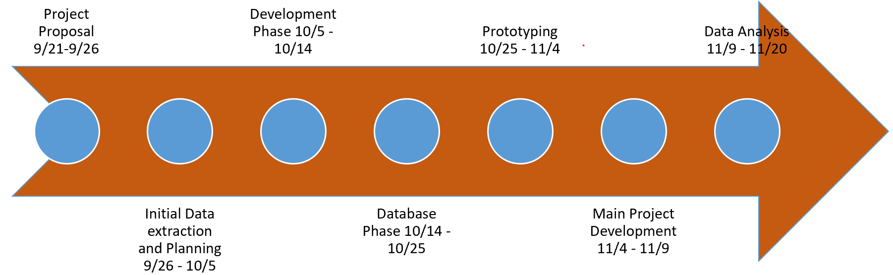
Workflow and Timeline
We divided our work into seven stages: Proposal Phase, Initial Extraction Phase, Development Phase, Database Phase, Prototype Phase, Main Project Phase, and the Data Analysis Phase.

Slide 8
Data Collection
3 Large data sets
Complete version history for each package
Includes all dependents
Source: NPMPackages.json.gz
Weekly download history for each package
Source: NPMjs API
Weekly download history for each dependent
Source: NPMjs API
Used MongoDB for storage

Slide 9
Analyzing our Data and Detecting Events
Detect Significant Rise/ Fall Events
For each package compare weekly download data to previous week
If % difference is >30% or < -30%, we have an event
Filter out events that aren’t at least 30% the size of highest ever downloads to determine which events are significant
Add/ Drop Correlation Detection
Add compares to rise, while drop compares to fall
If time difference is in the past 7 days or the following 4, we say a correlation exists (this should then be manually checked for causation)
Notes:
Well great, now we have data, but we have somewhere on the order of 50,000 data points.
What data do we actually need to look at?

Slide 10
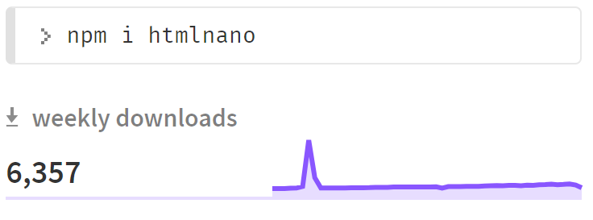
Patterns and Explanations
Add/ Drop
Similar download 𝚫 in dependent package
New version release
Holidays
Unexplained events
316,782
4,500
4,582
Notes:
I can throw numbers at you all day, but what does a “significant event” actually look like?
Here we have an example of an event in the package htmlnano. As you can see, there is a significant rise, and then subsequent fall (or a “spike”) in downloads.

Slide 11
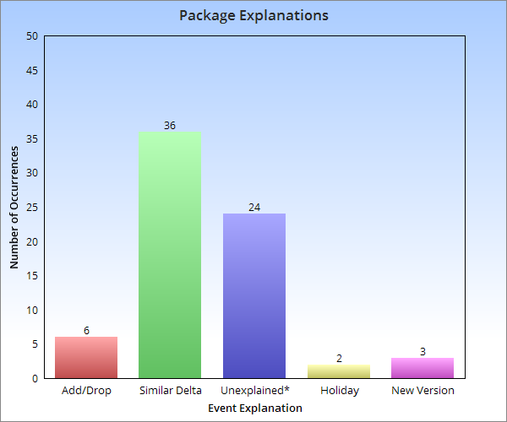
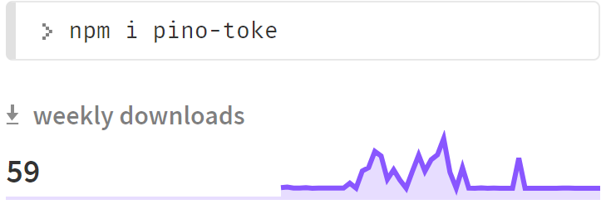
Our Findings
Across 30 checked packages, we detected 71 significant rise/ fall events
*pino-toke was responsible for 12 occurrences
Notes:
We looked at 30 different packages, and across those packages, we detected 71 significant events.
We had 6 Add/ Drop, 36 Similar Delta, 24 Unexplained, 2 Holiday, and 3 New Versions.
However, it is worth mentioning that the package pino-toke, who’s download data is highly erratic, accounted for half of our unexplained events, and if that outlier is removed our numbers look much nicer.

Slide 12
Limitations/Scope and Recurring Issues
Consecutive weeks of rises or consecutive weeks of falls
Rise early in packages history
If there are two rises, but one is significantly larger than the other only the larger one is detected
Rises coming off of NPM downtime
Recurring Issue: Re-writing large pieces of code multiple times
Recurring Issue: Re-running data retrieval

Slide 13
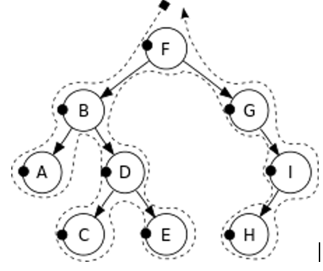
Future Work and How Our Model Can Be Used
It is our hope that our application can be used either as a basis or a guide for future developers.
Supervised machine learning could be used to simplify our algorithm and make it more efficiently and accurately recognize a suspicious package or pattern. In other words, it would greatly enhance the ability to find the cause of an event.
Additionally, a depth-first recursive search could be implemented and built upon to look deeper into possible causes and dependent lists. This search would traverse a packages dependents like a search tree and would be very useful for dependent download spikes

Slide 14
Conclusions
The overall experience in creating our application was extremely worthwhile. Each group member gained valuable experience throughout the duration of the project. This included:
Working on a software project in a team setting
Modern software development experience
Experience coding a new language (Python)
Learning how to use GitHub for collaborations

Slide 15
Questions?

